Slide 1
Low to High Resolution Image:
Predictive Modeling
Project 3 ~ Group 3 ~ Applied Data Science ~ Fall 2018

Slide 2
Outline
01. Introduction
01-1. Team Members
01-2. Project Goals
02. Predictive Modeling
02-1. Methodology
02-2. Improved Model
03. Results
03-1. Image Comparison
03-2. Improved Model Validation

Slide 3
01
Introduction
01-1. Team Members
01-2. Project Goals

Slide 4
Team Members
Yingqiao Zhang: yz3209@columbia.edu
Shiqing Long: sl4225@columbia.edu
Ghada Jerfel: gj2261@barnard.edu
Peilin Li: pl2672@columbia.edu
Xiaoyi Li: xl2694@columbia.edu

Slide 5
Goals
Improve the baseline GBM model
Evaluate different predictive models
Assess and validate the selected model

Slide 6



Low-Resolution
High-Resolution

Slide 7
02
Predictive Modeling
02-1. Methodology
02-2. Improved Model

Slide 8

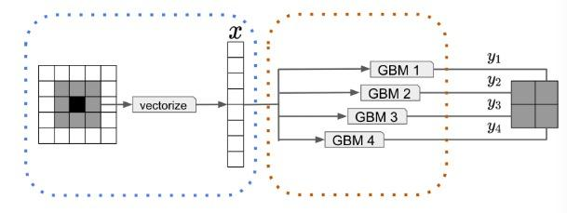


Methodology
Different Predictive Models
Feature Extraction
Baseline Model
Gradient Boosted Stumps
Model Assessment
SPEED
PSNR
MSE

Slide 9
THE IMPROVED MODEL
XGBOOST
It is an improved Implementation of the GBDT model
It performs more accurately
It saves time

Slide 10
03
Result
03-1. Image Comparison
03-2. Improved Model Validation

Slide 11



Image Comparison
Here are some examples to show our high-resolution result
Baseline Model
Low-Resolution
XgBoost Model

Slide 12



Image Comparison
Here are some examples to show our high-resolution result
Baseline Model
Low-Resolution
XgBoost Model

Slide 13


Improved Model Validation
BASELINE MODEL
XGBOOST MODEL
SPEED:
Feature Extraction: 74.988s
Model Training: 680.839s
Super Resolution: 2224.718s
MSE: 0.003858453
PSNR: 24.13587
SPEED:
Feature Extraction: 89.549s
Model Training: 546.012s
Super Resolution: 2057.754s
MSE: 0.002802863
PSNR: 25.52398

Slide 14
THANK YOU

